Slide 1
CAP476:
Data Communication and Networking
Unit-I
Network Models

Slide 2
Network Models Introduction
Systematic approach for data transmission
Models enable orderly communication
Responsible for sender-receiver connection
Ensure smooth, efficient data flow
Two main models: OSI, TCP/IP

Slide 3
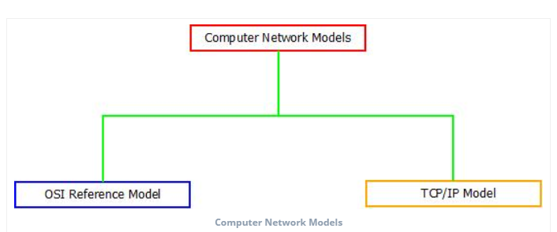

Slide 4
Layered Architecture
Design divided into small pieces
Lower layer supports higher layer
Modularity, clear interfaces provided
Services, protocols, interfaces involved
Aids easy modification, testing

Slide 5
Why Do We Require Layered Architecture?
Breaks complex network into layers
Each layer performs specific function
Enhances modularity and easy modifications
Allows independent development and testing
Reduces design, troubleshooting complexity

Slide 6
OSI Reference Model
OSI: Open System Interconnection
Developed by International Organization for Standardization (ISO), 1984
Standard for computer communications
Divides network tasks into 7 layers
Each layer independent, task-specific

Slide 7
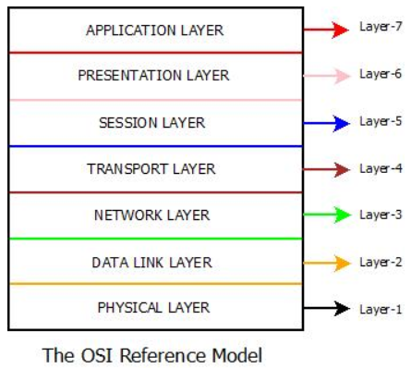

Slide 8
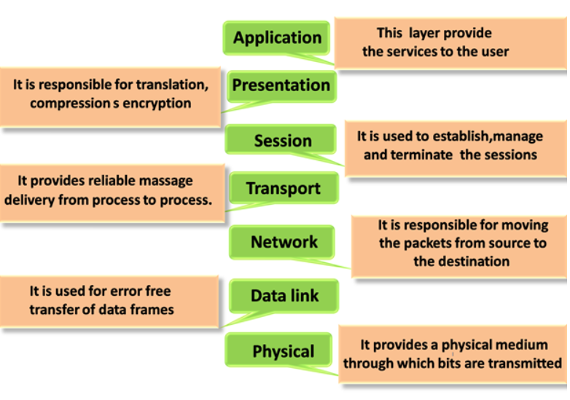
Functions of the OSI Layers

Slide 9
THANK YOU

